Slide 1
Particle size and shape
Size measurement of fine particles
Defining a fine particles
Particle characterization
(defining a particle/distribution)
Course Distribution
Particle size investigation
Measurement
Industrial screening equipment
Sieving
Primary/Coarse size reduction
Size Reduction
Intermediate size reduction
Particulate solid handling
and their properties
Fine size reduction
Dynamics of particle in liquid medium
Classification
Sedimentation
Solid-Liquid separation
Separation
Flotation
Miscellaneous methods
Solid-Gas separation
Dynamics of particle in gas medium
Fluidization
Storage, Handling and Transport of Solids
Storage of solids
Transport of solids

Slide 2
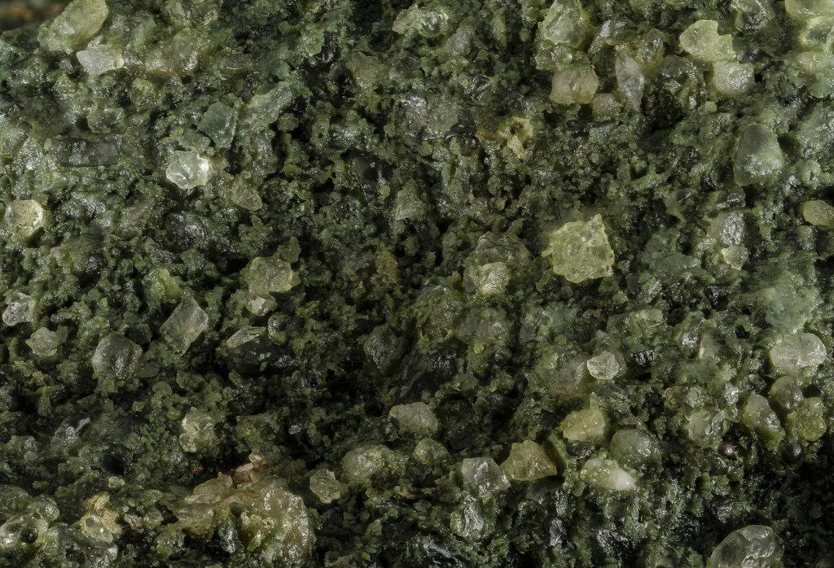

IIT Kharagpur
NPTEL
PARTICLE CHARACTERIZATION

Slide 3
A liquid is a hen-pecked husband whereas a solid particle is a male chauvinist……

Slide 4
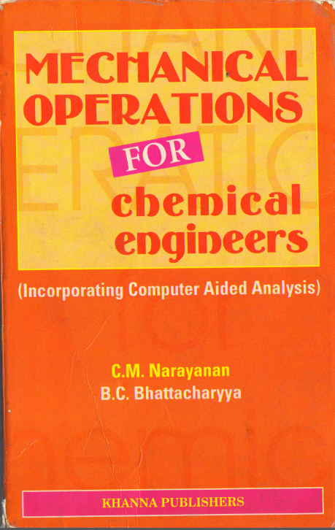
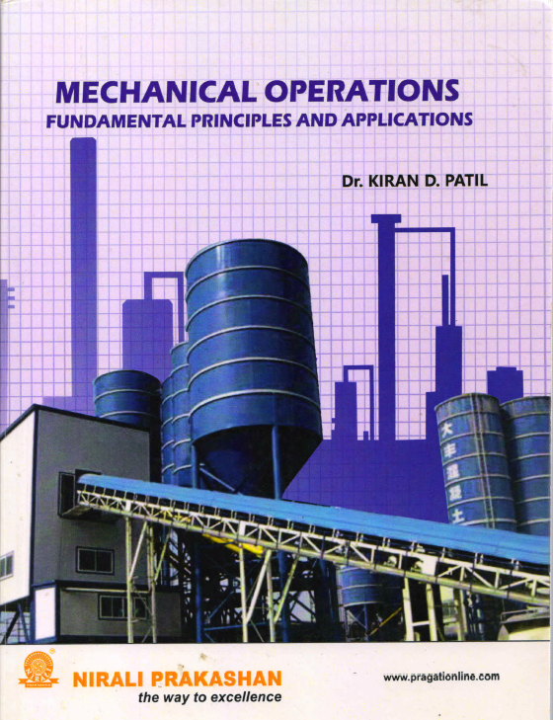
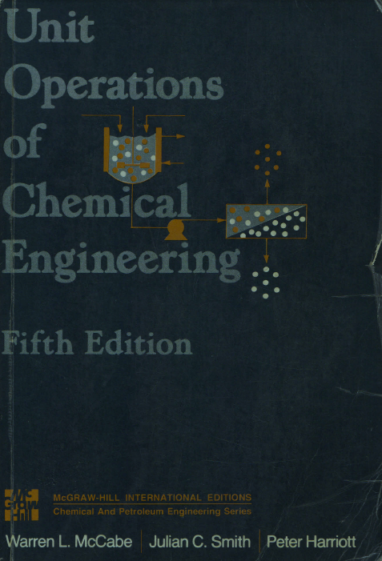
Books

Slide 5
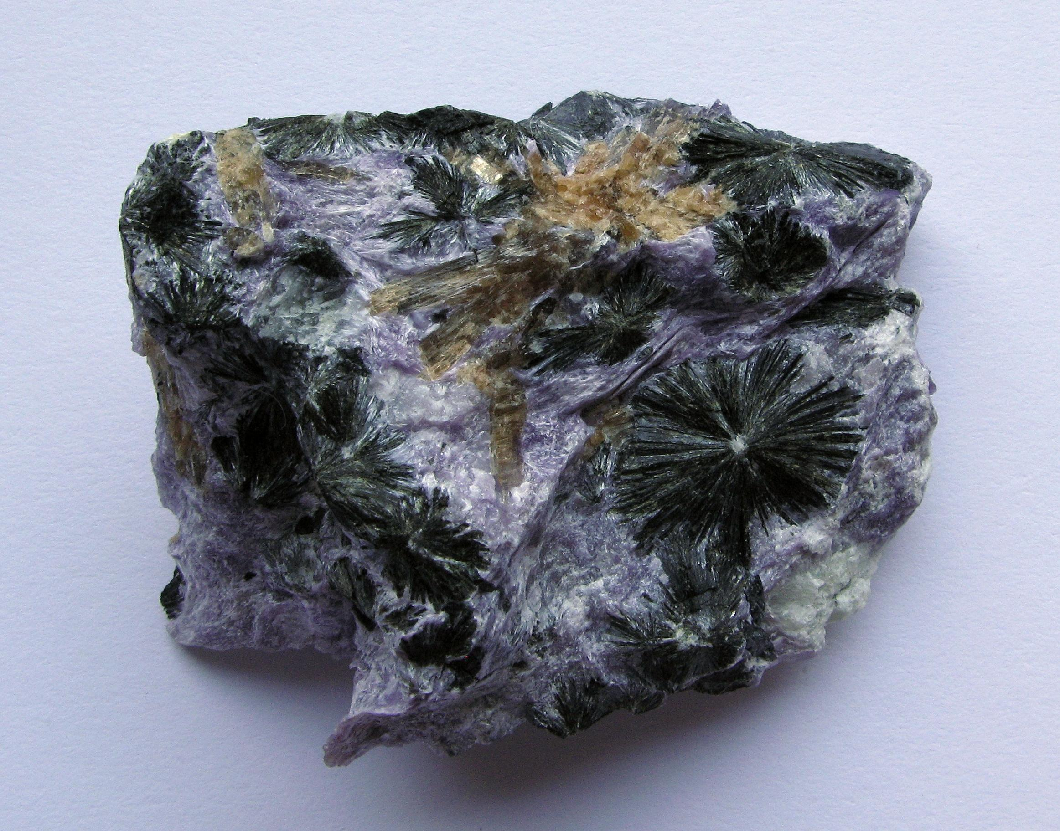
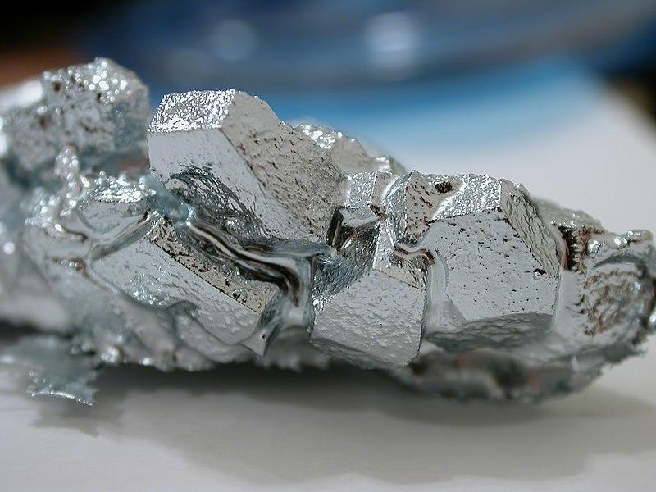
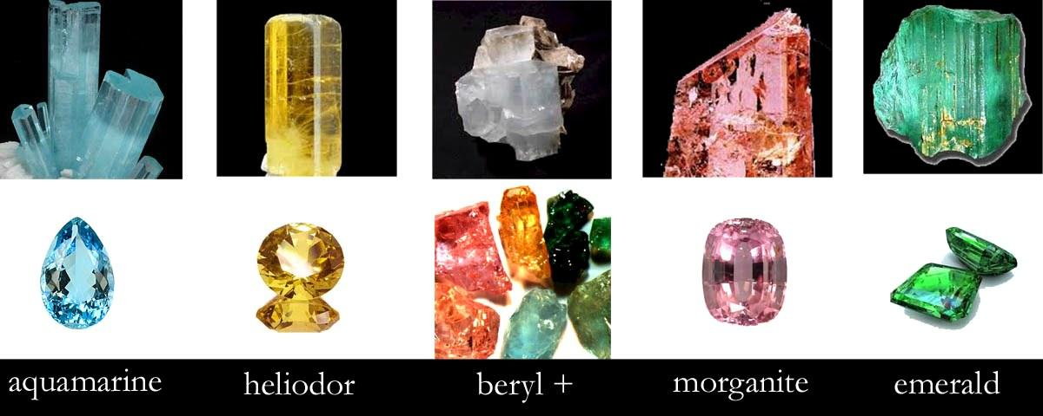
Particle Properties
Physical
Hardness,softness
Tenacity,brittleness,friability
Structure, fracture
Friction
Aggregation, stickiness
Colour, lustre
Electro-conductivity
Magnetic susceptibility
Change in mechanical properties by heat
Aggregated particles
Soft mineral - Gallium
II. Physio-Chemical
Surface Properties- Adhesion, polarity, contact angle
Change in magnetic properties by heat
Change in properties on adding depressants, activators
Different colours of minerals

Slide 6
Individual solid particles are characterized by their
Size
Shape
Density
Note:
Particles of homogeneous solids have the same density as the bulk material.
Particles obtained by breaking a composite solid such as a metal bearing ore, have various densities, usually different from the density of the bulk material.
Size and shape are easily specified for regular particles such as cubes and spheres but for irregular particles (such as mica flakes) the terms size and shape must be properly defined.

Slide 7

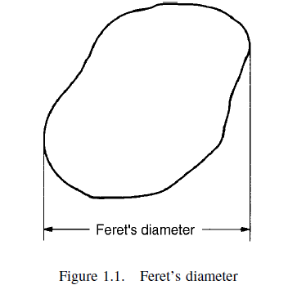


How to define the size of a irregular particle ?
What else can be done to empirically define a particle size?
Geoffrey Martin, 1923 : Defined the size of an irregular particle as length of line bisecting the maximum cross-sectional area of the particle.
L. R. Feret, 1930 : Distance between the two most extreme points on the particle surface
Fails to define the actual size and shape of irregular particle
1. G Martin, CE Blyth, H Tongue - Transactions of the Ceramic Society, 1923
2. Feret, L. R. La grosseur des grains des matières pulvérulentes. 1930

Slide 8
Later,
Particle size was defined by comparing with spherical particle with the characteristic length as the equivalent diameter (D_{pe}).
Size of an irregular particle can be broadly defined as
The size of spherical particle having the same controlling characteristic as particle under consideration
What do we mean by controlling characteristic ?
Depends on the system/process on which the particle is involved.
Example: Catalysis process Surface area (d_{s})
Free Settling Mass (d_{v})

Slide 9
Definitions of derived diameter
Surface diameter, d_{s}: the diameter of sphere having same surface area as the particle
Volume diameter, d_{v}: the diameter of sphere having same volume as the particle
Drag diameter, d_{d}: the diameter of sphere having the same resistance to motion as the particle in a fluid of the same viscosity and at the same velocity
Projected diameter, d_{p}: the diameter of the sphere having the same projected area as the particle when viewed in a direction perpendicular to a plane of stability
Stokes diameter, d_{st} = (d_{v}³/d_{d})^{1/2} the free falling velocity in the laminar region
Sieve diameter, d_{avg}: the width of the minimum square aperture through which the particle will pass.
Volume surface diameter d_{vs} = d_{v}³/d_{s}² , the diameter of a sphere having same specific surface area as the particle under considertion

Slide 10
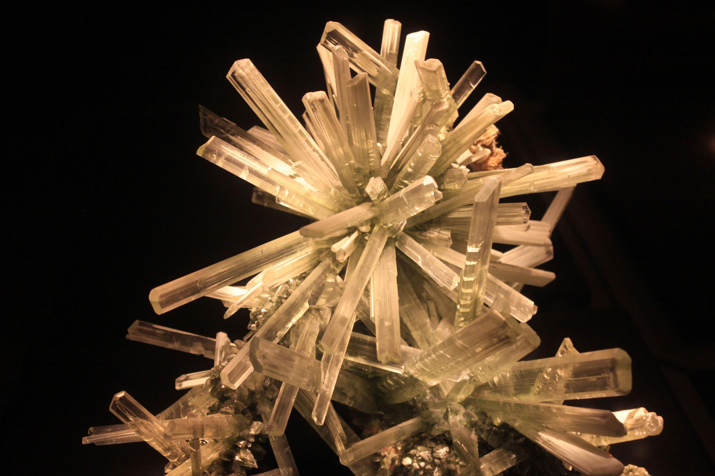
Different Shapes:
Acicular (needle shaped)
Angular , crystalline, dendritic (having broken chain crystalline shape), fibrous, flaky or
lammentar, granular, irregular, nodular (having a rounded irregular shape), spherical
Particle shape
One of the method of defining shape is by using the term sphericity .The sphericity is defined as the ratio of surface area of a sphere having the same volume as that of the particles to the actual surface area of the particle
Acicular shape of particles
.….(1)
Where, d_{v} is the volume diameter of the particle
Note: It defines only the particle shape and is independent of particle size.

Slide 11
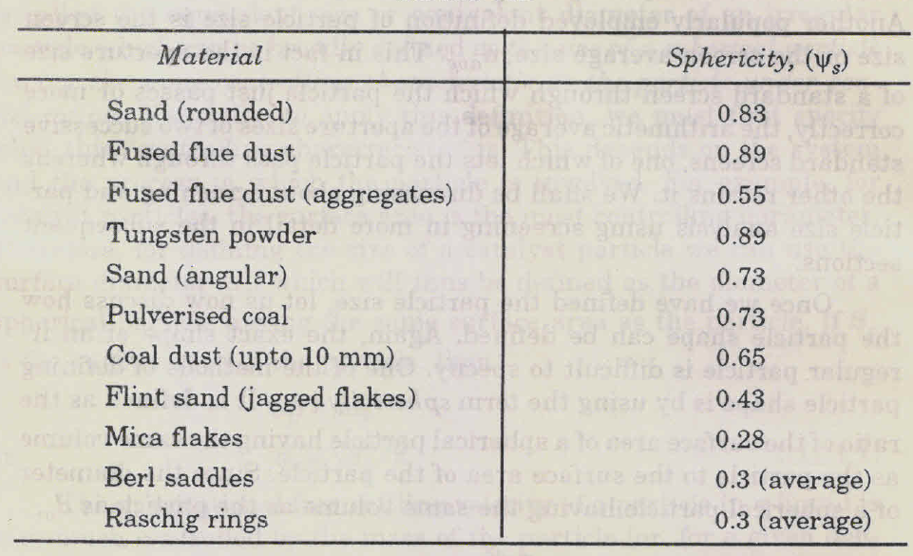
Sphericity of different materials

Slide 12
Shape factor
The reciprocal of sphericity is called the shape factor or surface shape factor
.….(2)
Example: Find the sphericity and Shape factor of a cubical particle of a side a
Volumetric diameter of the particle :
Sphericity:
Shape factor :

Slide 13
For irregular particles, as shown in the table, λ_{s} is greater than one. For many crushed materials it’s between 1.5 and 1.7. Commercial tower packing are made to have higher surface to volume ratios and λ_{s} for such particles is large in the range of 3 to 5.
Shape factor for miscellaneous materials
Material | Shape factor, λ_{s} | Material | Shape factor, λ_{s}
Sphere | 1.0 | Mica flakes | 3.6
Cylinder, L= D | 1.14 | Crushed glass | 1.5
Cube | 1.24 | Coal dust pulverized | 1.4
Round sand | 1.2 | Sharp sand | 1.5
NB: The particle shape has an effect on such properties as flowability of powders, packing , interaction with fluids and the covering power of pigments.

Slide 14
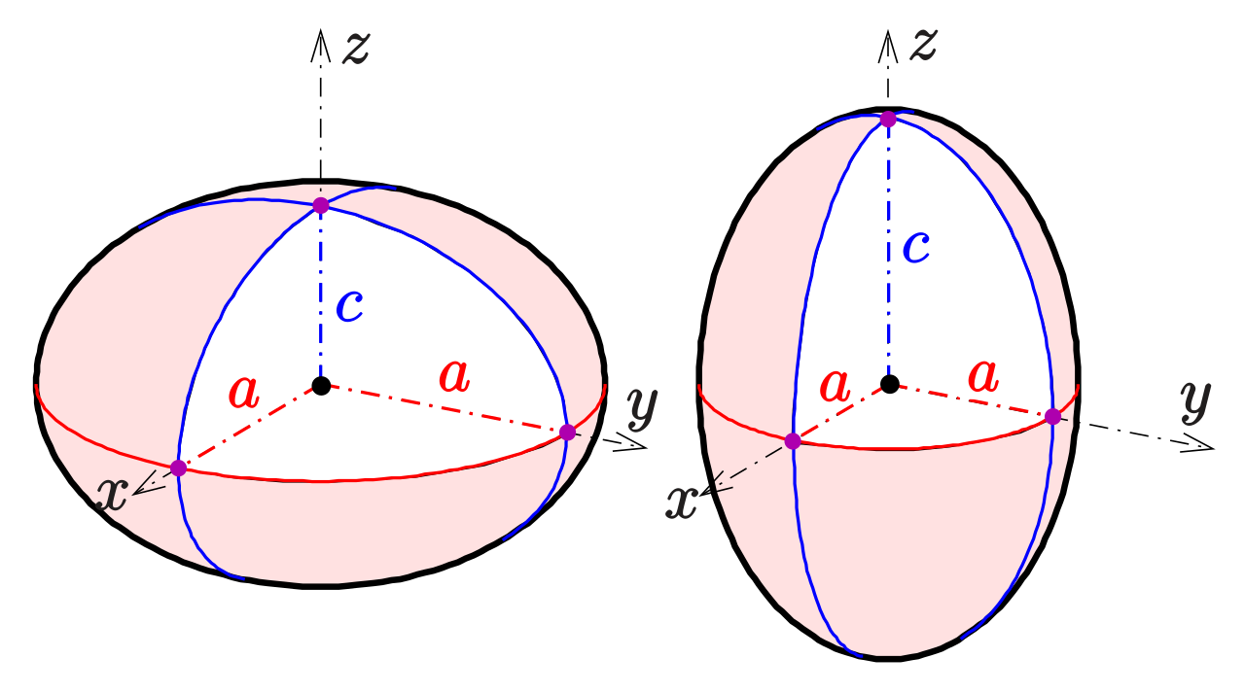
A spheroid, or ellipsoid of revolution, is a quadric surface obtained by rotating an ellipse about one of its principal axes
c < a: oblate spheroid
c > a: prolate spheroid
a = Equatorial radius (6378.14km)
c = Polar radius (6356.75 km)

Slide 15
Specific surface ratio (n)
Ratio of the specific surface ( surface per unit mass, s_{p} ) of the particle to the specific surface of a spherical particle of the same diameter
If the average size of the particle is d_{avg,} then
.….(3)
Where, ρ_{s} is the density of the particle
Relation with sphericity
.….(4)

Slide 16
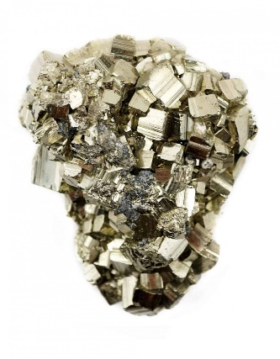
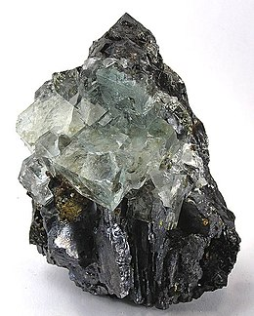
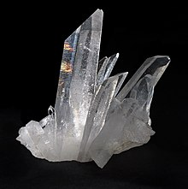
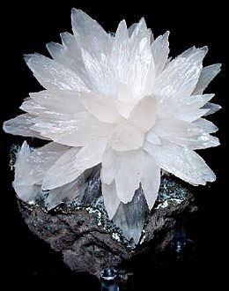
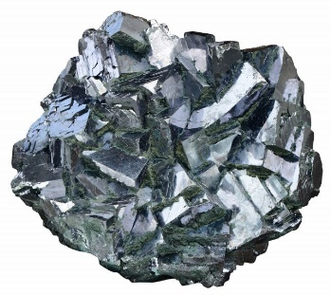
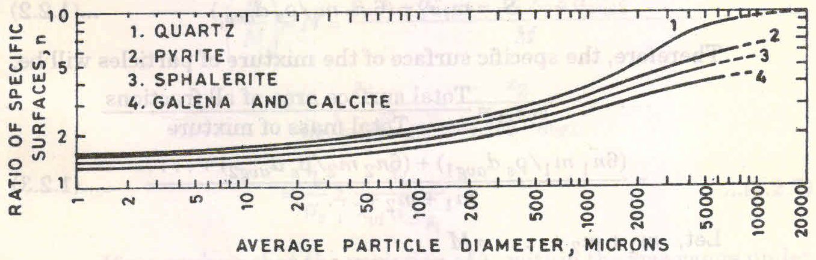
Special case
The mineral pyrite, or iron pyrite, also known as fool's gold, is an iron sulfide with the chemical formula FeS
When, d_{avg}=d_{v} ;
n=λ_{s}
Quartz is a mineral composed of silicon and oxygen atoms in a continuous framework of SiO₄ silicon–oxygen tetrahedra, with each oxygen being shared between two tetrahedra, giving an overall chemical formula of SiO₂.
Sphalerite is a mineral that is the chief ore of zinc [(Zn,Fe)S]
Calcite is a carbonate mineral and the most stable polymorph of calcium carbonate (CaCO₃)
Natural mineral form of lead(II) sulfide
Otherwise,
It must be noted that unlike sphericity, specific surface ratio n is a function of particle size (d_{avg} )

Slide 17
Volume shape factor ( λ_{v} )
Sometimes used to calculate the volume of an irregular particle
Volume of an irregular particle is assumed to be proportional to the cube of its diameter ( which is true for a spherical particle )
Or
.….(5)
The constant of proportionality λ_{v} is called the volume shape factor
λ_{v} is actually not constant ( though designated as shape factor) but a function of the particle size.
In number of cases the variation of λ_{v} with particle size is not very large and an average value is considered for calculation.

Slide 18
Mixed Particle Sizes
In real industrial process, we normally deal with mixtures of particles of different sizes.
The mixture can be separated into a number of fractions with each fraction consisting of particles of given size d_{avgi}
Let m_{i} be the total mass of the i-th fraction.
The specific surface of the i-th fraction can be calculated using equation 3 as
.….(6)
The surface area of the i-th fraction
.….(8)

Slide 19
Mixed Particle Sizes
The specific surface area of the mixture (s_{m})
Where, x_{i} is the mass fraction of the ith fraction in the mixture= (m_{i}/M) and M is the total mass of the system
Recall n is the specific surface ratio

Slide 20
Number of particles in the i-th sample (N_{i}) :
Total number of particles per unit mass of the mixture :
.….(9)
If the distribution of the particle ( x_{i} vs d_{avgi}) is known the specific surface area and the number of particle per unit mass of the mixture can be calculated.

Slide 21
The average particle size for a mixture of particles may be defined in several ways.
1) arithmetic mean :
4) Volume mean :
2) Length mean :
5) Square root mean:
3) Surface mean :
6) Cube root mean:
7) Harmonic mean:

Slide 22
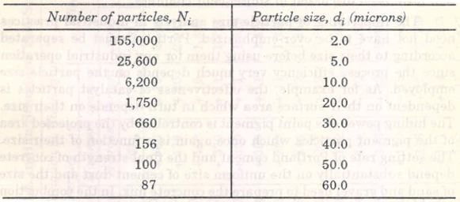
Example: Calculate the statistical average diameters

Slide 23
Method of particle size investigation
There are various methods or techniques available for the determination of particle size
S.No | Method/ Technique | Particle radius in micron
1 | Sieving (dry or wet) ordinary sieving air jet sieving | Above 40 20 – 120
2 | Sedimentation gravity centrifugal | 1 – 100 0.005 – 3
3 | Elutriation (liq or air) gravity centrifugal | 5 – 100 1 – 60

Slide 24
4 | Optical method light microscope ultra microscope electron microscope | 0.2 – 40 0.005 – 0.2 0.0005 – 5
5 | Light scattering and transmission | 0.1 – 30
6 | x-ray scattering | 0.005 – 0.05
7 | Permeability | 0.1 – 150
8 | Adsorption | 0.001-5

